Slide 1
Medical Management Course
Balliol College, Oxford
13th -14th Sept 2016
Please follow @OxbridgeMMC
Use #OxbridgeMMC for all your tweets

Slide 2
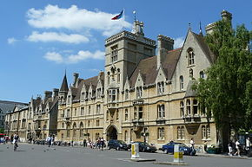
Balliol College
Balliol College was founded in about 1263 by John I de Balliol

Slide 3
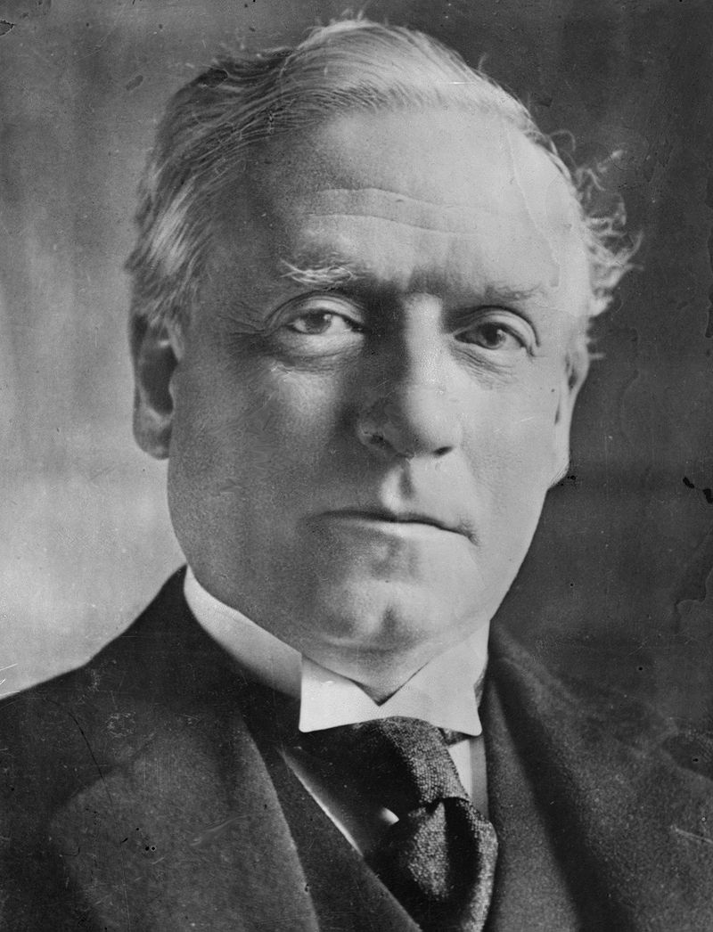
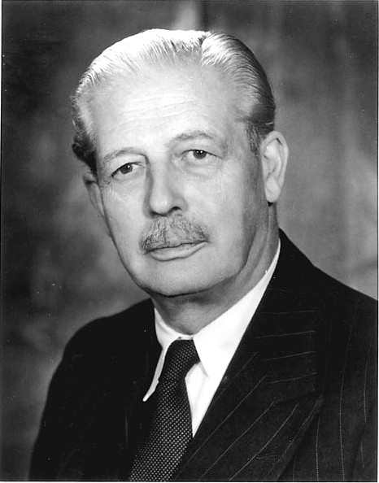
Balliol College
Alumni include:
3 prime ministers
"the tranquil consciousness of an effortless superiority“
HH Asquith
HH Asquith
(1908-16)
H Macmillan
(1957-63)
E Heath
(1970-74)

Slide 4
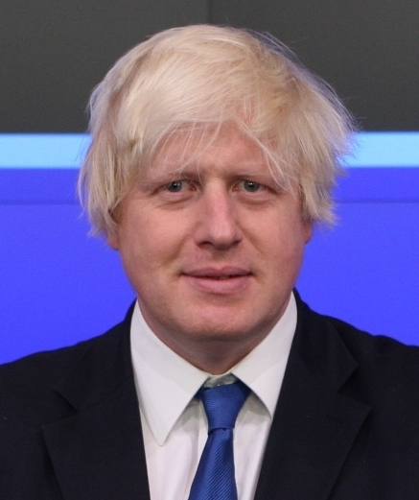
Balliol College
Alumni include:
3 prime ministers
HH Asquith
(1908-16)
H Macmillan
(1957-63)
E Heath
(1970-74)

Slide 5
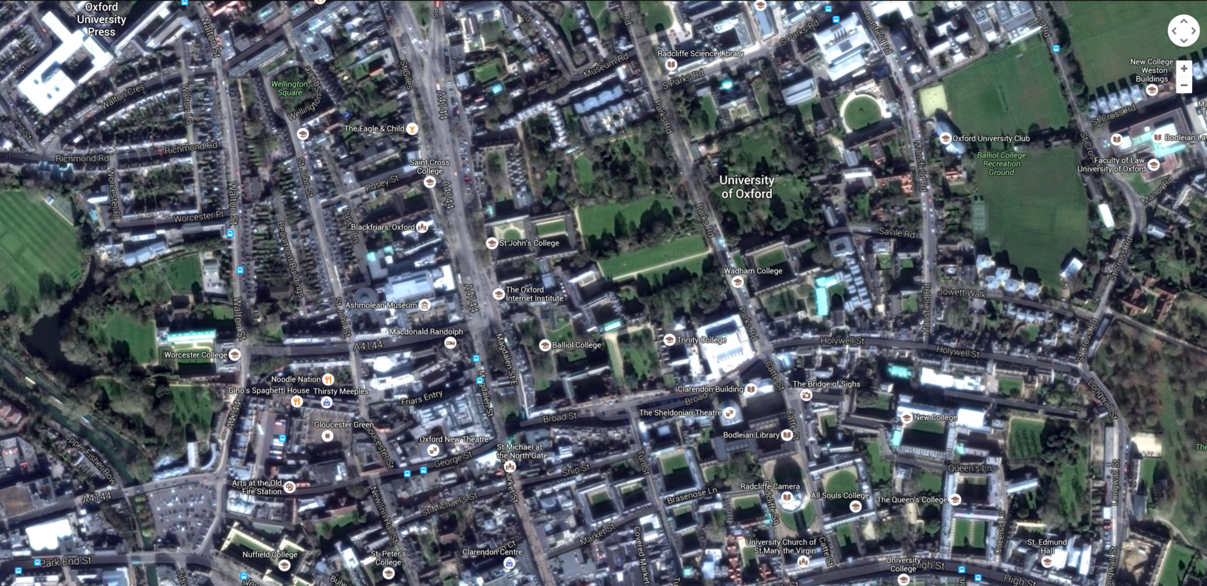
Balliol College

Slide 6
Housekeeping
Door code: 5412
Accommodation
Toilets
Catering
Breakfast – Hall
Tea & coffee – outside meeting room
Lunch - Hall
Dinner – SCR dining room
Emergency exits!

Slide 7
Admin
All slides will be provided in pdf form for you.
Please ensure you complete a feedback form.
Course certificate – emailed to you after the course.

Slide 8
Medical Management Course
Please follow @OxbridgeMMC
Use #OxbridgeMMC for all your tweets

